Slide 1

PRE PRIMARY

Slide 2
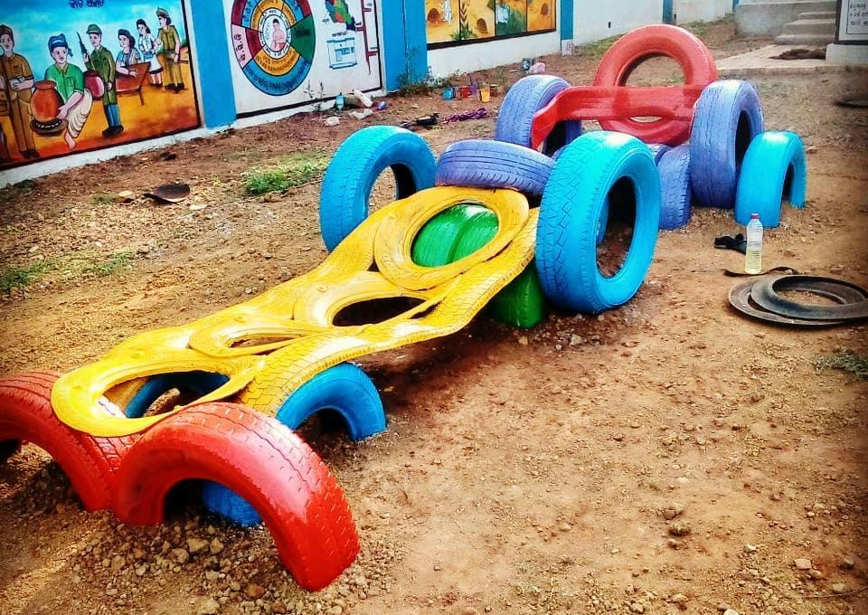

Let’s go on a drive!
Tyre Car
Number of Users : 5-7
Material: Tyres

Slide 3
How do we perceive a mini caterpillar?
ELEMENT B: Mini Caterpillar
Number of Users: 5-6
Material: 5Truck & 2Motorbike tyre

Slide 4
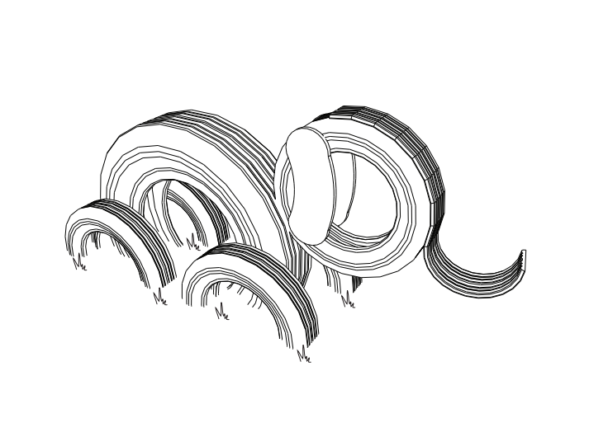
How do we perceive an Elephant
ELEMENT A : Elephant
Number of Users: 5-6
Material: 1 Tractor tyre, 2 truck and 9 car tyres

Slide 5
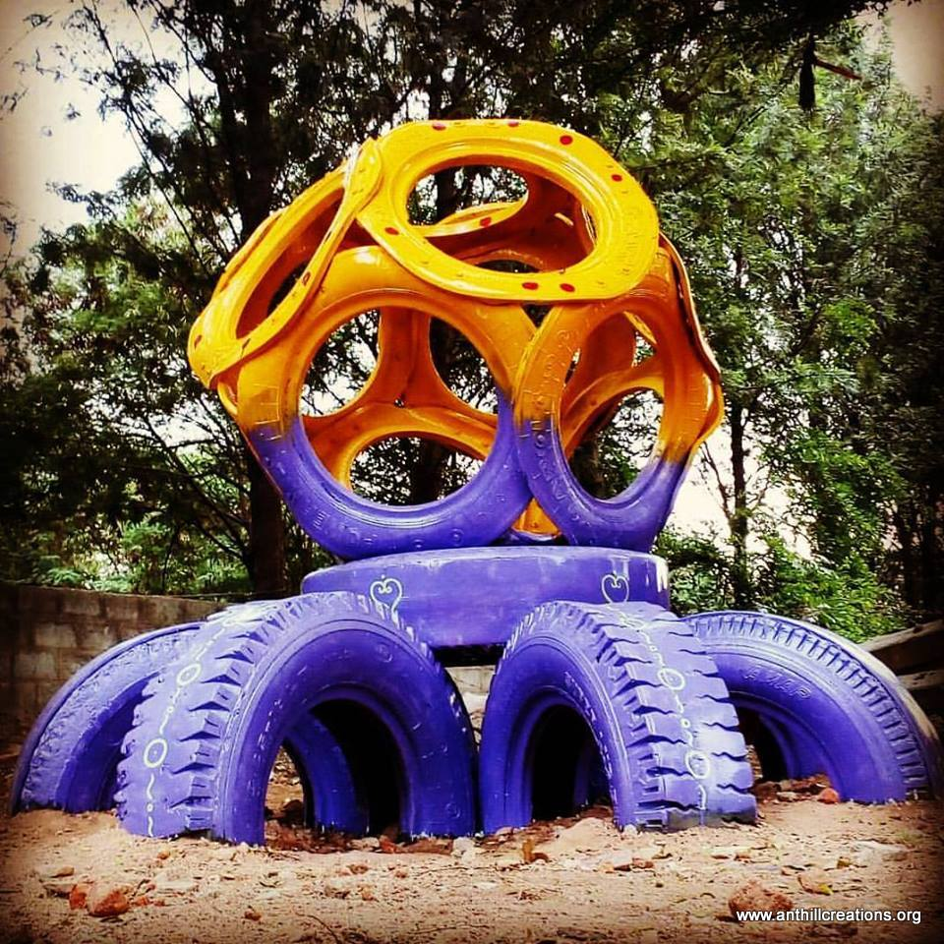
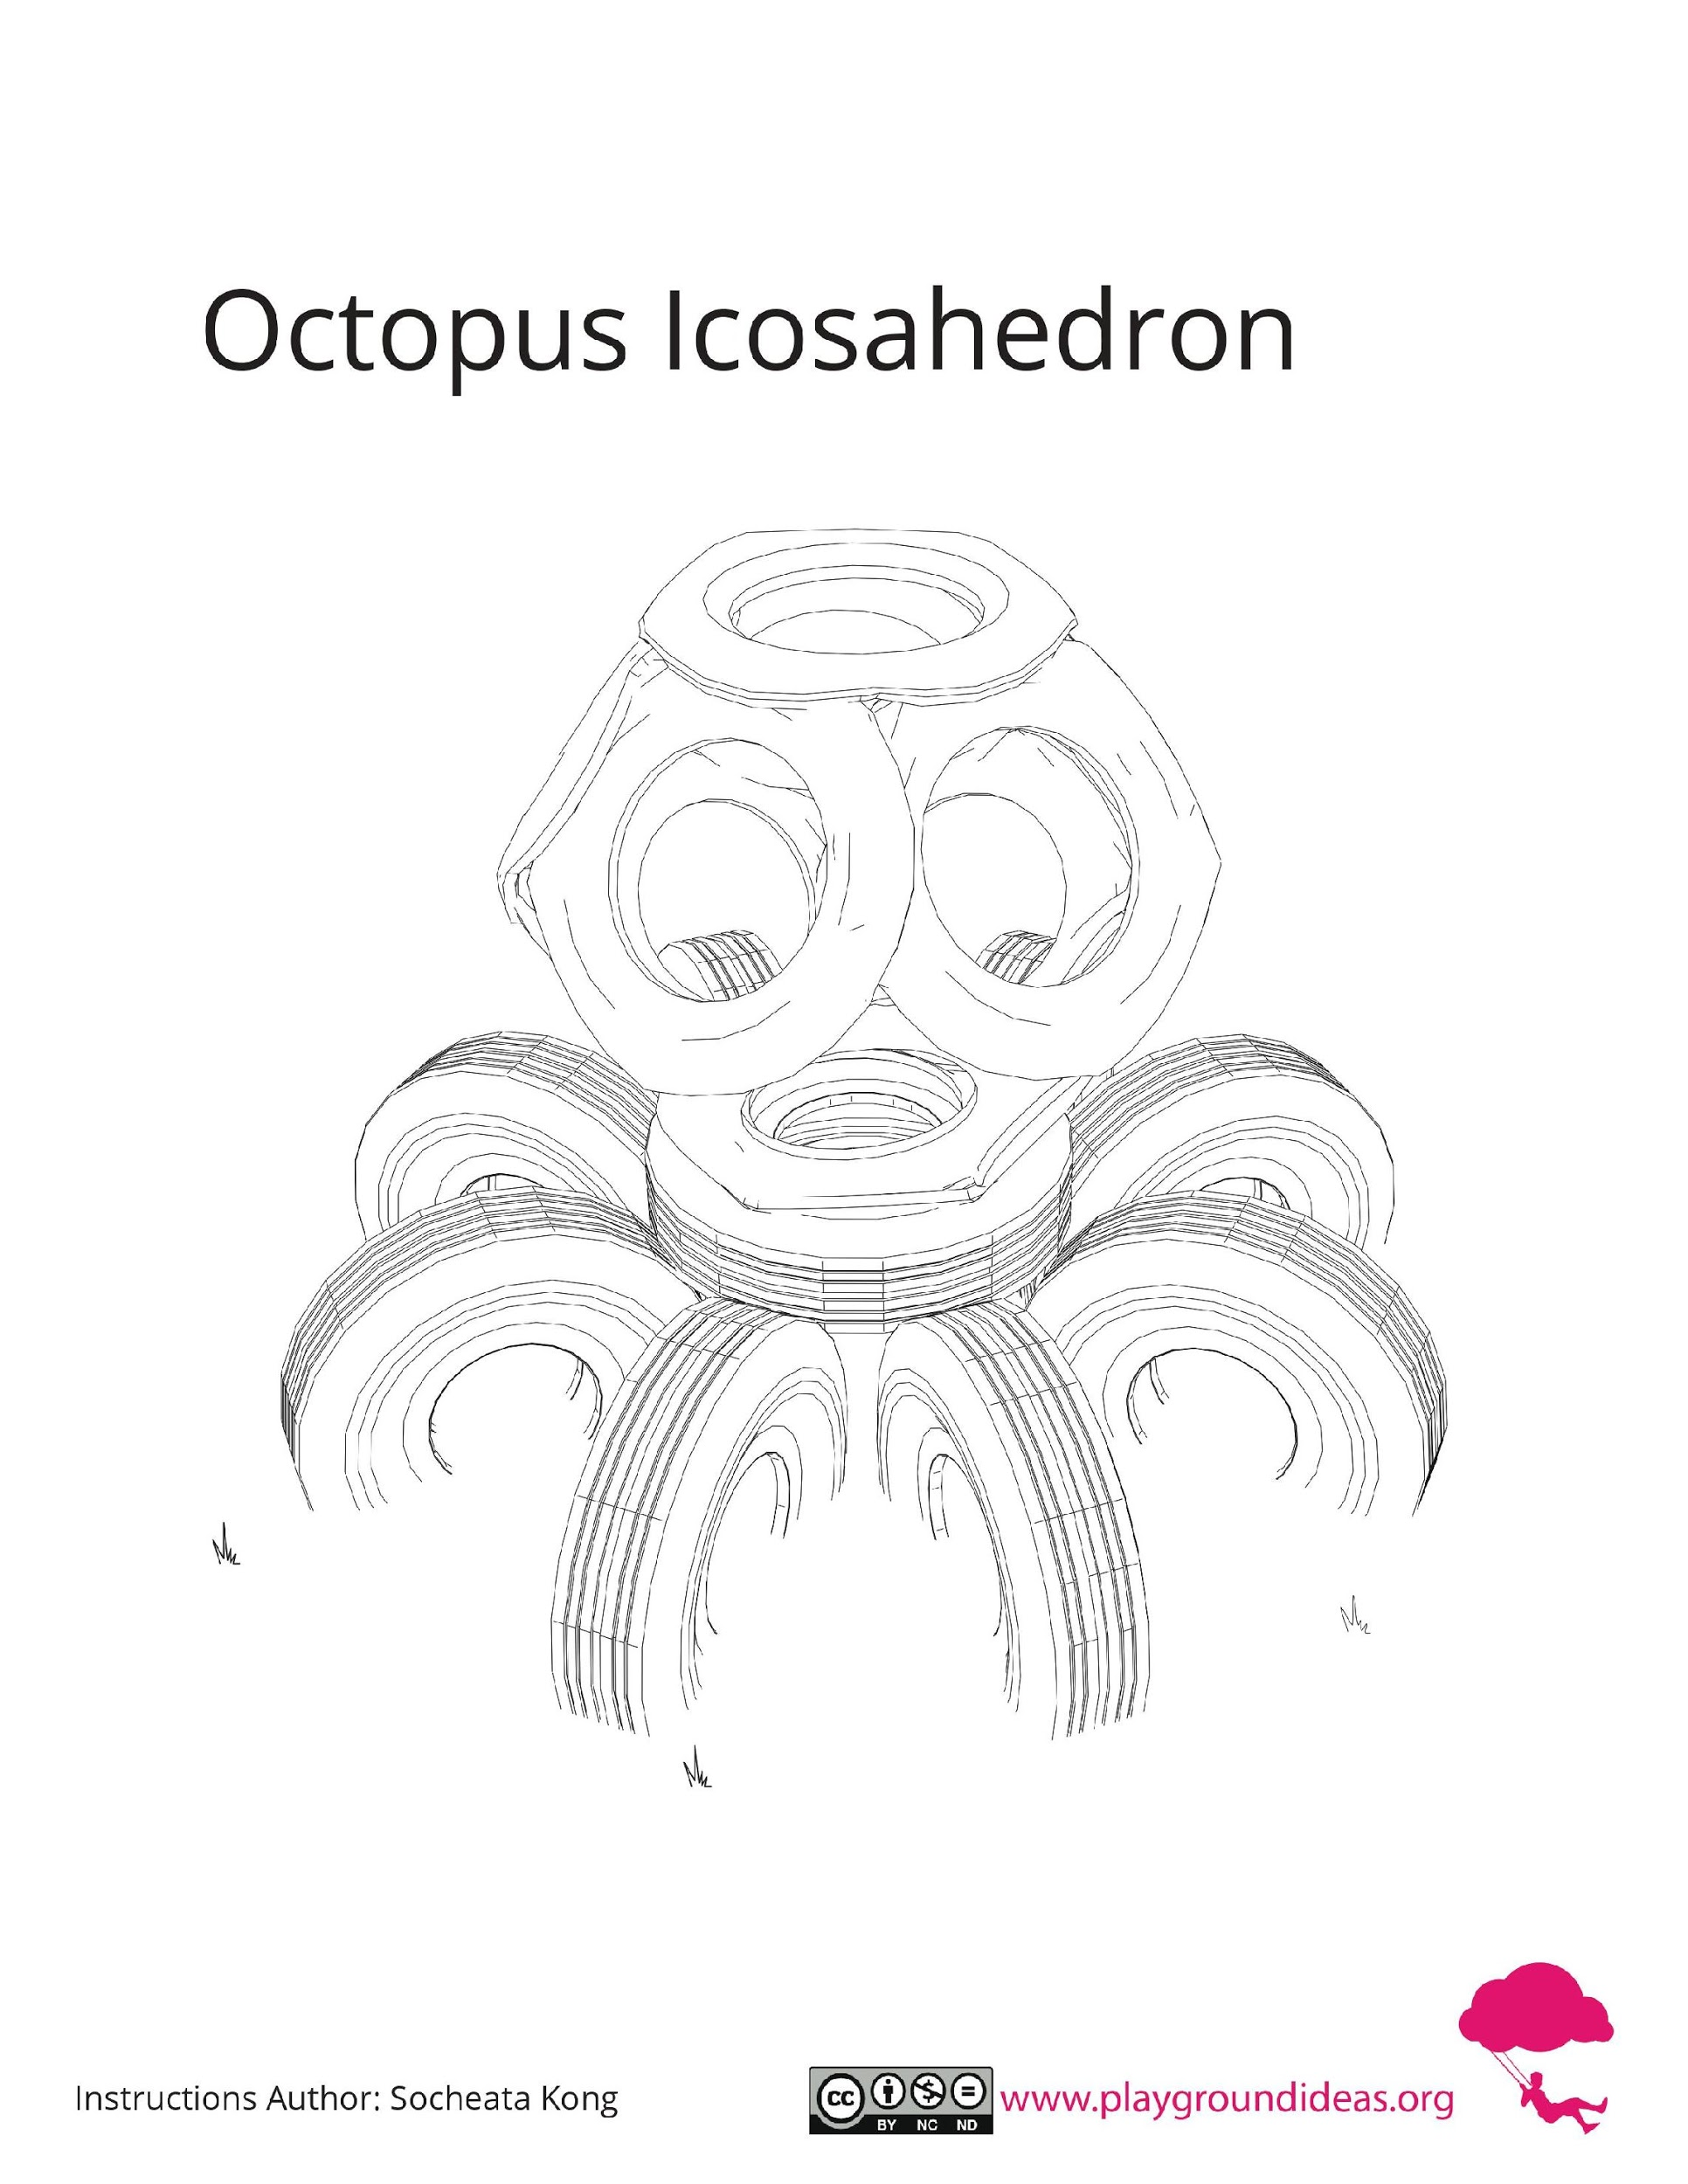
How do we perceive an octopus?
OCTOPUS
Number of Users: 5-6
Material: Tyres

Slide 6
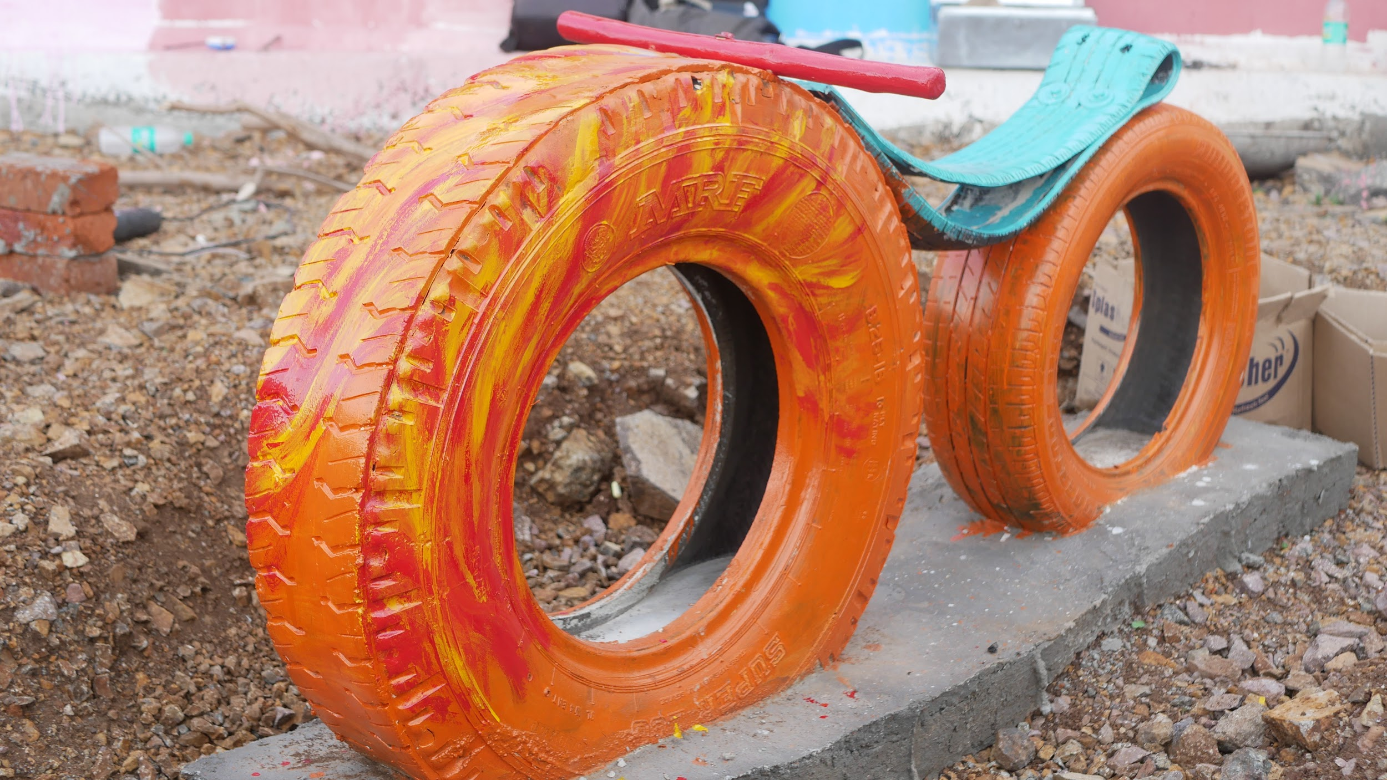
How do we perceive a Scooter?

Slide 7
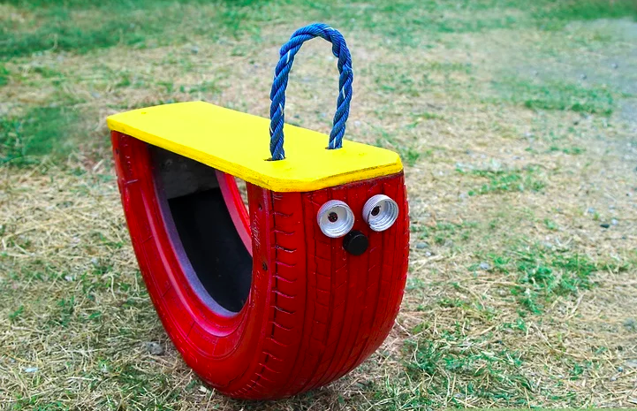
How do we perceive a rocking horse?
ROCKING HORSE
Number of Users : 1-2
Material: Tyres, Wood, Rope

Slide 8
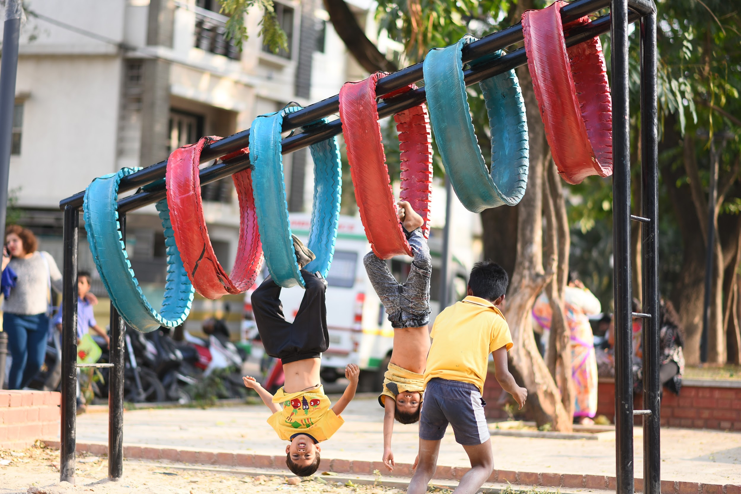
HEAVING HOOPS
The kids crawl through the tyres and the challenge is to pass through each loop. This is again a fun element, helping them increase their coordination.
We could install this with layers of truck tyres which are strong and are resistant to wear and tear, supported by metal frames anchored to the ground.
Note : The following image explains the idea of the element and the following element, will be detailed out such that, there would be no settling corners for snakes.

Slide 9
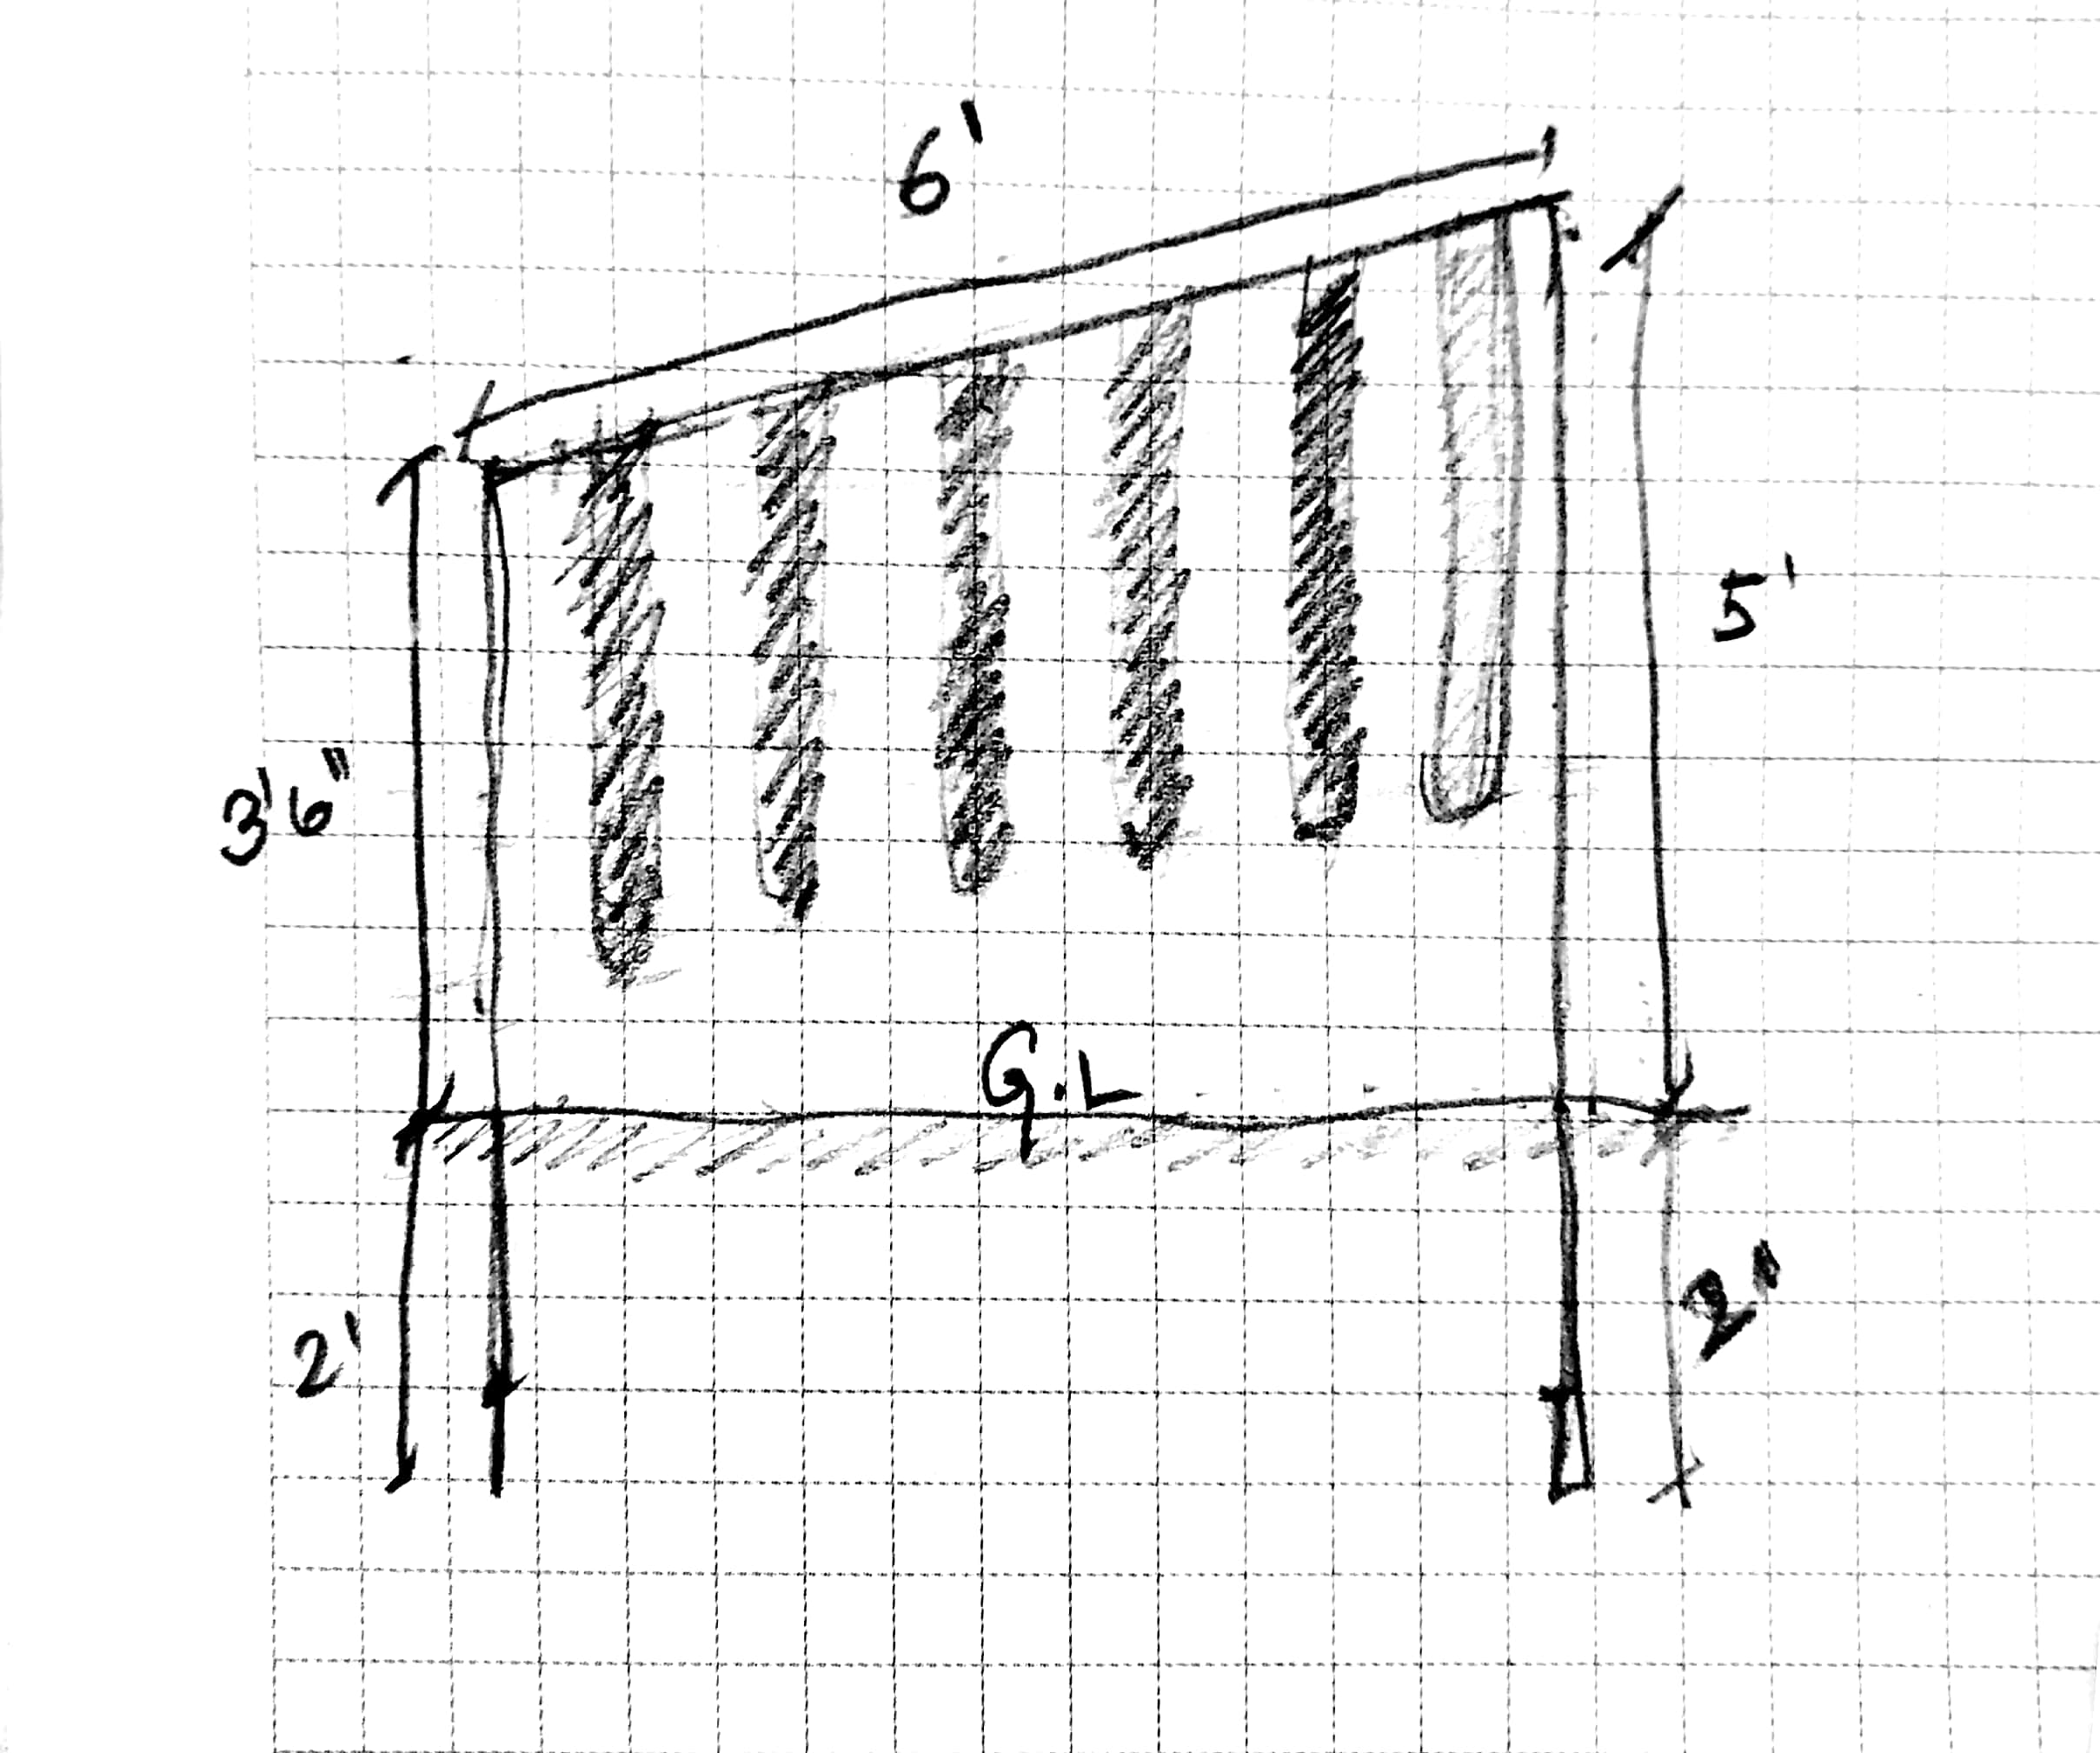
HEAVING HOOPS
execution instructions
The dimensions are in feet and inches.
3” MS Round pipe needs to be used and below the ground line the metal pipe needs to be fixed in the ground using concrete and hold fasts.
2 of the frames of the dimensions shown in the image will be connected to each other by the same rod of length (1’6”) on the top edge of the verticals.
divide the 6’ length into six parts and centre each cut tyre in each part.

Slide 10
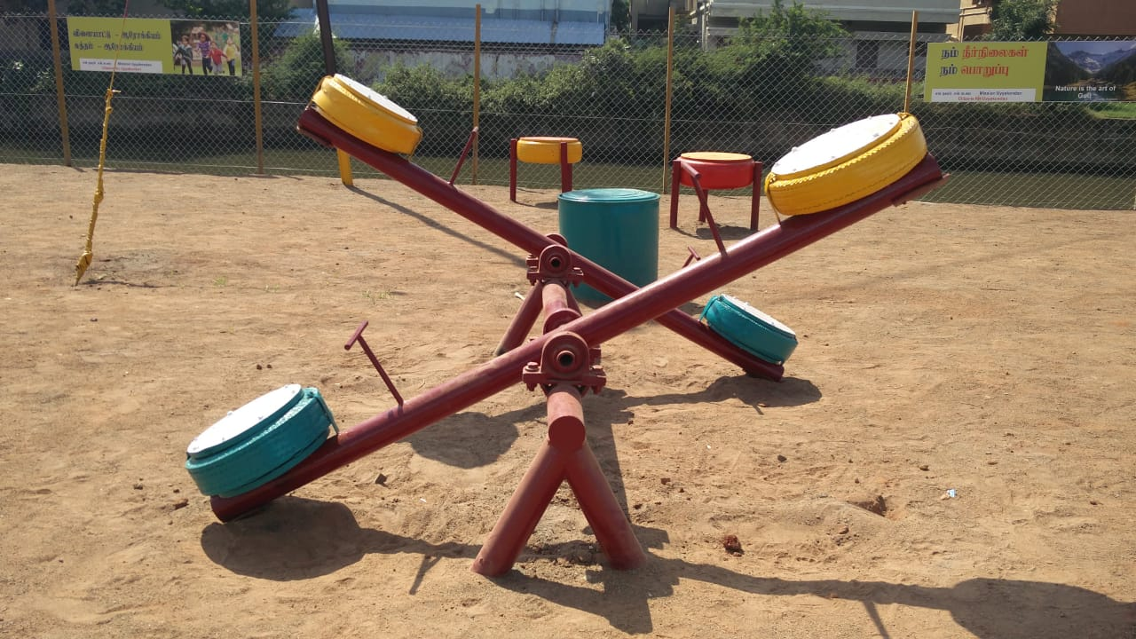
BOUNCY SEESAW
A seesaw is a lever, which is found in most of children's parks. A couple of seesaws would explain some science and the idea of balance. This particular seesaw is designed to give a bounce when they hit the ground. With a central pivot of truck tyre on which the entire see saw would be supported. Thus it would be all the more fun!!
Note : The following image explains the idea of the element and the following element, will be detailed out such that, there would be no settling corners for snakes.

Slide 11
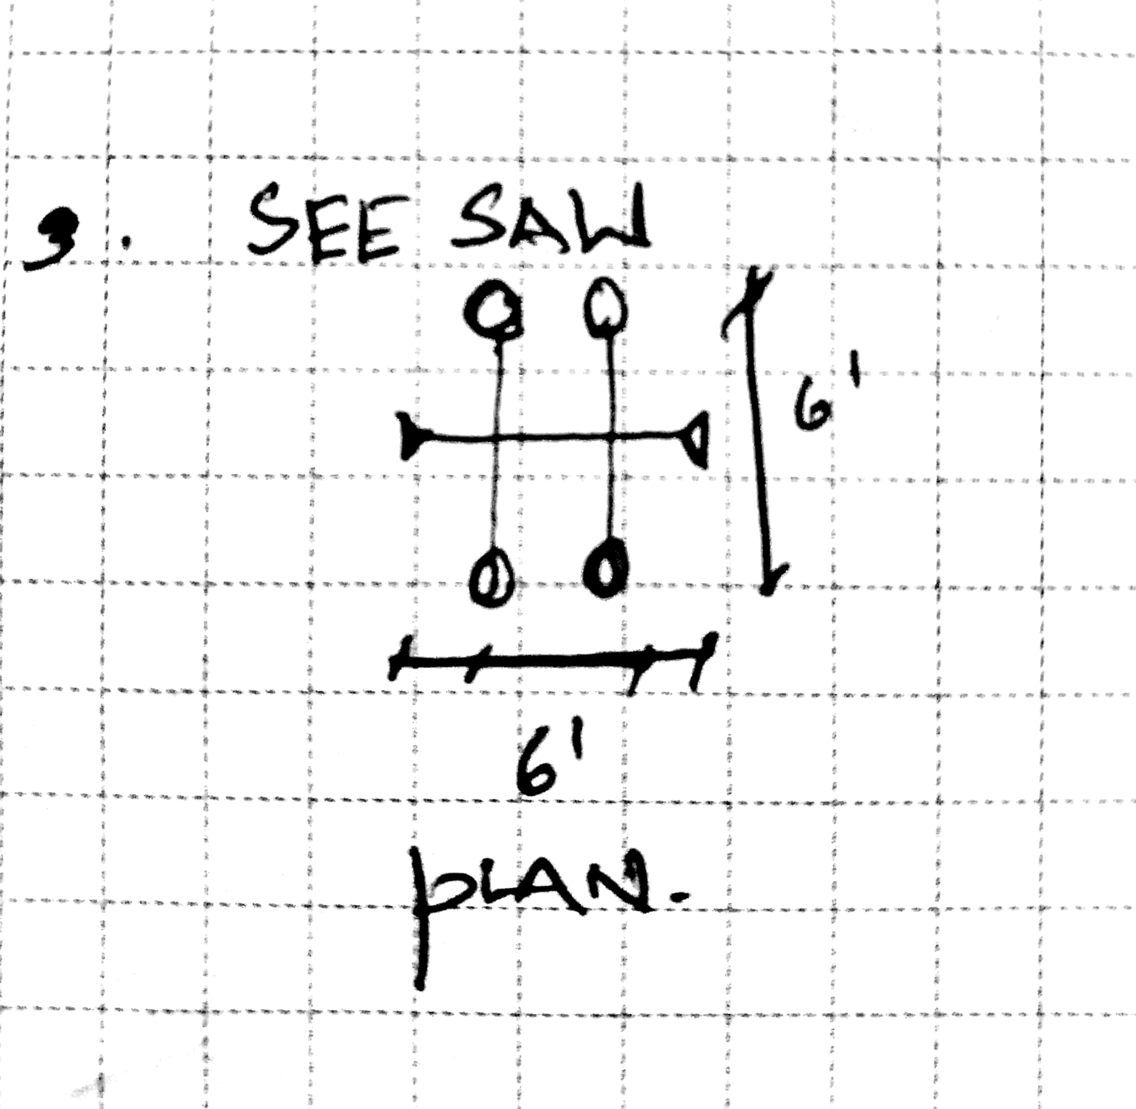
HEAVING HOOPS
execution instructions
The dimensions are in feet and inches.
3” MS Round pipe needs to be used and below the ground line the metal pipe needs to be fixed in the ground using concrete and hold fasts.
The edge to edge dimension of the seesaw is 6’X6’
Pillow blocks need to be centred and placed for smooth seesaw mechanism and The tyres to be covered with wooden boards.
As this is a snake prone zones the tyres need to be covered with wooden boards which are weather resistant on both sides.

Slide 12
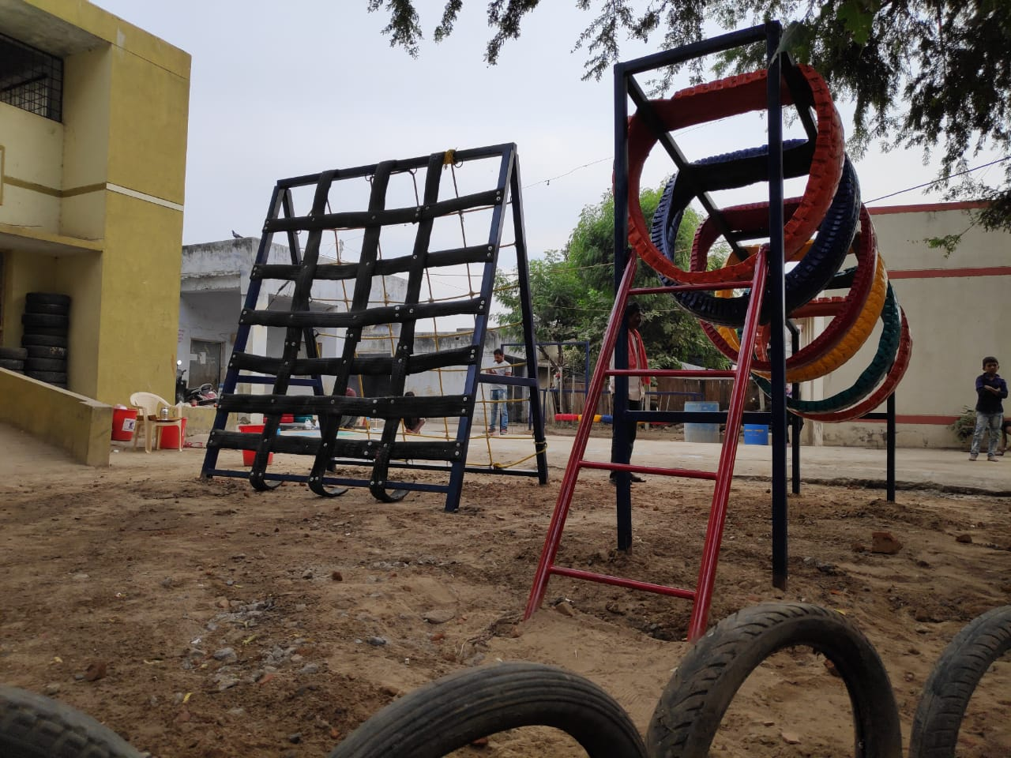
TYRE CLIMBER
A climber is an element which would help them coordinate better and achieve targets. This would enrich their body and mind coordination.
Note : The following image explains the idea of the element and the following element, will be detailed out such that, there would be no settling corners for snakes.

Slide 13
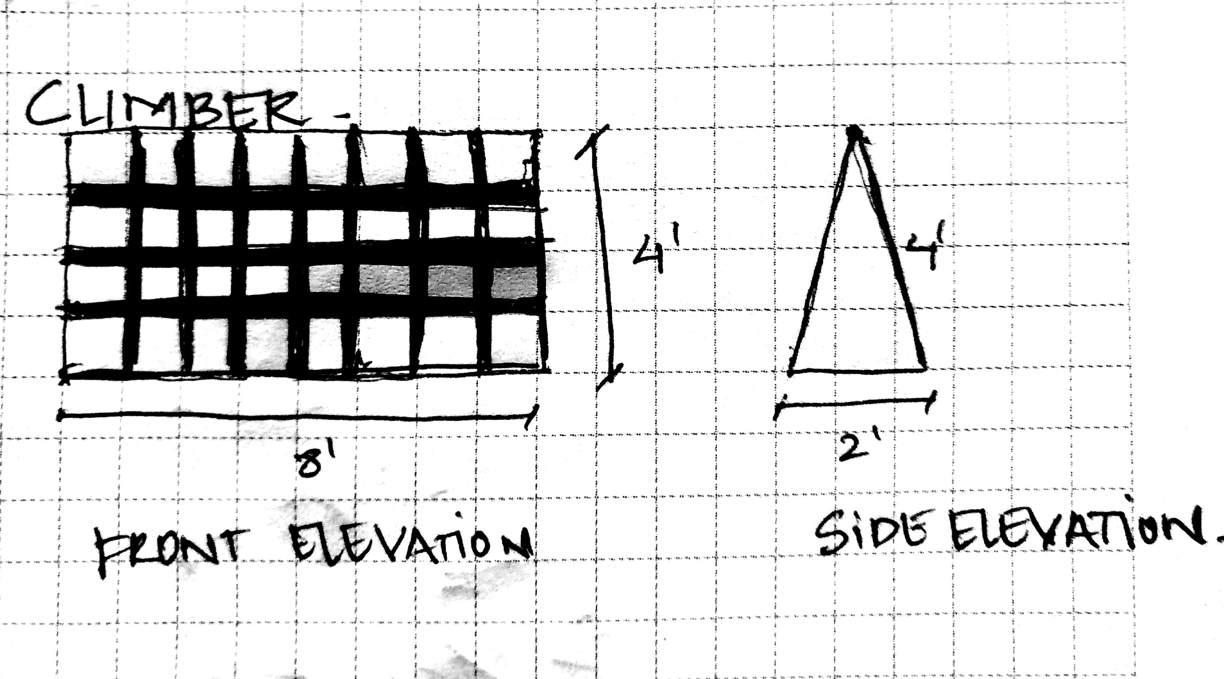
TYRE CLIMBER
execution instructions
The dimensions are in feet and inches.
3”X3” MS Box pipe needs to be used and below the ground line the metal pipe needs to be fixed in the ground using concrete and hold fasts.
We would use Nylon ropes on one side and cut tyres on the other side

